Slide 1
SAP BTP Extension Suite Training
Day 21
Anubhav Oberoy
www.AnubhavTrainings.com
Follow excellence with sheer passion

Slide 2


DISCLAIMER
The training content and delivery of this presentation is confidential, and cannot be recorded, or copied and distributed to any third party, without the written consent of Anubhav Trainings

Slide 3
Agenda – Day 21
01
Build Apps
02
First App
03
Use Case App 2

Slide 4

Create your first hello world application

Slide 5
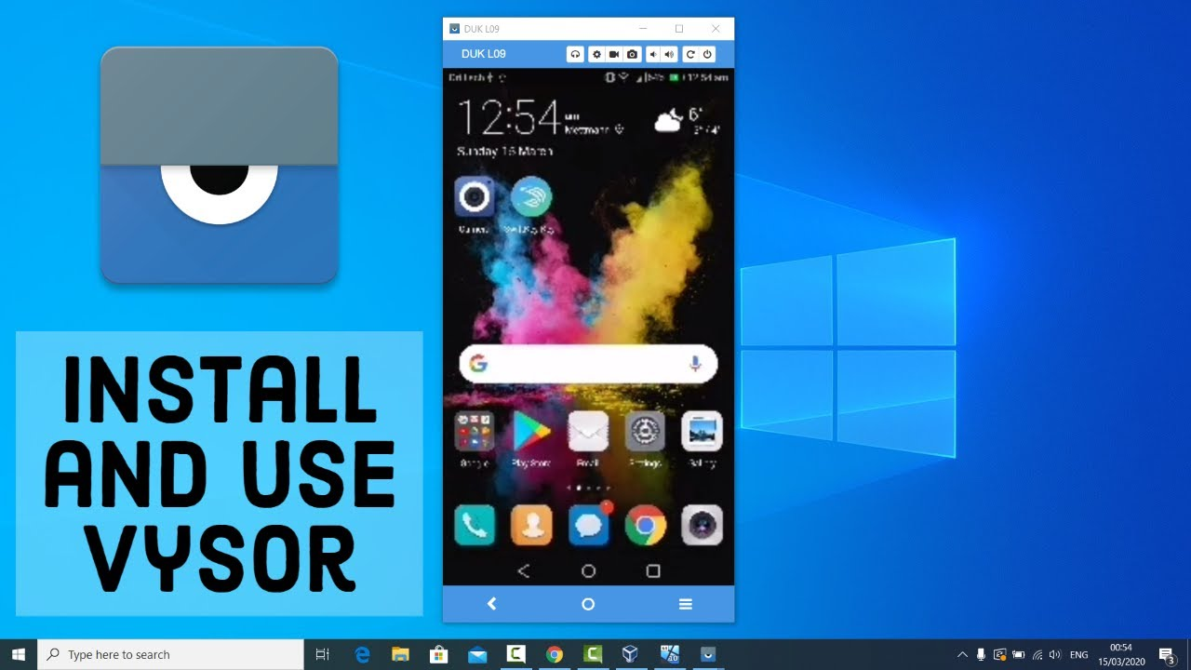
Test your app

Slide 6
Android Developer mode
Open Settings: Access the Settings app on your Android device.
Navigate to About phone: Go to About phone (or About device) within the Settings menu.
Tap Build number: Locate the Build number and rapidly tap it seven times.
Confirm Developer Options: You'll see a message indicating you've enabled Developer Options.
Access Developer Options: The Developer Options menu will now appear in your main Settings menu.

Slide 7

Use case 2
Persona:
Name: Priya
Age: 32
Role: A health-conscious mother of a 6-year-old boy
Goal: To ensure her son eats healthy snacks, avoiding high sugar, additives, or allergens
Scenario:
Priya is grocery shopping on a busy weekday afternoon. Her son loves trying new snacks, but Priya is always worried about hidden sugars, preservatives, and allergy-triggering ingredients. Reading tiny labels on packaging is time-consuming and frustrating.
Key Features of the App:
- Barcode scanning
- Instant nutrition info from Open Food Facts
- Allergen warnings
- Healthy alternatives
- Kid-focused nutritional grading
Benefit:
Priya saves time and makes informed decisions, ensuring her son enjoys tasty snacks without compromising health.

Slide 8
What is JSON – Java Script Object Notation
{
key: ‘value’,
key: ‘value’,
key: ‘value’
}
orderNo shipTo date
101 | SHIP1 | 20251212

Slide 9
What is API?
API stands for application programming interface, it is a contract between our system and a system which is trying to connect with us.
API gives a contract between caller and called party
That makes integration possible w/o knowing internal functionality of system
Critical role in integration and exchange of data between systems
Servers as single entry point for different business objects (so,po,material)

Slide 10
API HUB
SAP provides a publicly available website. Any developer can go and explore the APIs offered by SAP Solutions e.g. S/4HANA, BTP, Success Factors, Field Glass, Concur etc.
https://api.sap.com
You can request S/4HANA server access – server@anubhavtrainings.com

Slide 11
Open APIs
Open Food Facts offers a comprehensive API that allows developers to access a vast database of food product information, including details such as ingredients, nutritional content, allergens, and labels. This open-source database is continually enriched by contributors worldwide, making it an invaluable resource for applications focused on health, diet tracking, food research, and consumer information. citeturn0search0
Key Features of the Open Food Facts API:
- Extensive Data Access: Retrieve detailed information about food products, including ingredients, nutritional facts, allergens, and more.
- Global Coverage: Access data from a wide range of products sourced from various countries, providing a diverse and comprehensive dataset.
- User Contributions: Benefit from a continually growing database, as users worldwide contribute by adding new products and updating existing information.
- Integration Flexibility: Utilize the RESTful API to seamlessly integrate food product data into mobile apps, research projects, software, or diet-based web services.
https://world.openfoodfacts.net/api/0/product/8904004400083?fields=product_name,nutriments,image_front_url
Sample products –
8901764061257
8901262200189
8901063029279
8904004400083

Slide 12

What We Did
Let’s Summarize

Slide 13

www.anubhavtrainings.com
Thank You
End of Day 20

Slide 14


We’re committed to empower you to be
#FutureReady
through powerful training solutions.
We build the workforce of the future.
260+
Corporate Clients
60,000+
Learners Trained
26000+
Learners Placed
FREE WEBINARS
Sign up for free webinars with industry experts every fortnight!
Enroll Now!
Contact us today!
https://anubhavtrainings.com

